Slide 1

DriverPass System Analysis
Joseph Eaton
Notes:
[No speaker notes required for this slide.]

Slide 2

System Requirements
Functional Requirements:
The system shall register/login users when the correct information is given.
The system shall allow users to order and schedule driving tests with instructors.
Nonfunctional Requirements:
The application will need to have enough storage to be able to store all the data within the web app and the database
The application must be able to be access via any internet browser.
Notes:
When looking at the needs of our system one if the crucial functional requirements its allowing a user to one register and two login so that they can actually access the system. The 2nd functional requirement is one of our other big features the client is wanting which is the user to order and schedule in person driving tests with instructors. In terms of the non functional requirements that show the most importance for our client is creating a scalable program that will be able to store user data and a reliable app for users ensuring they can acess any of their information no matter which browser they are using
\

Slide 3
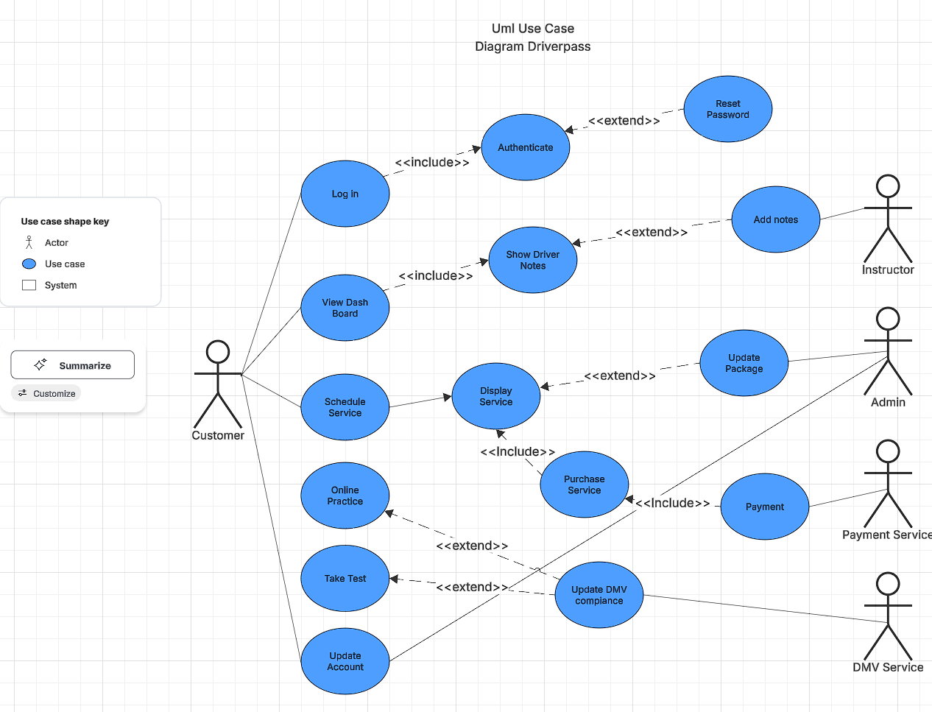
Use Case Diagram
[Insert your use case diagram here.]
Notes:
When looking at our use case diagram we need to look at the outside pieces of our system which includes the customer, instructor, admin, payment service and the dmv service. Our actions that the system uses will allow these outside pieces use meet our clients needs by allowing the customer to login and be authenticated whilst also allowing them to view the dashboard and look at driver notes that are posted by our instructors. The dmv service allows the sytem to stay updated with all the latest dmv changes which was a must by the client. Some other actions that will be used by the user and the admin to both make alters to accounts. The user is able to book a scheduled package while the payment service verifies that purchase and the admin either adds another package or removes it.

Slide 4
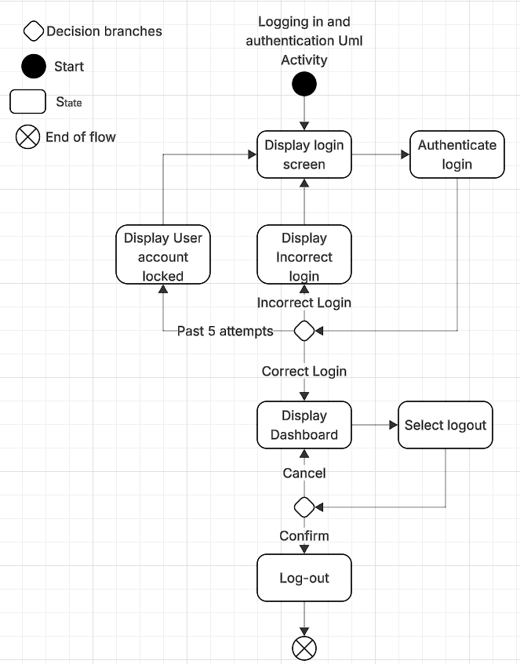
Activity Diagram
[Insert one of your activity diagrams here.]
Notes:
The use case that I am breaking down is the user logging in it starts with the login screen being displayed followed by the system authenticating the login information if that is the incorrect logging the system will display incorrect login and send them back to the login screen to try again now if the user has attempted this 5 times it will display and lock the user out of their account to prevent brute force attacks which was a must from the client if the login was correct it will take the user to the dashboard in which case the user will see other options and be able to logout.

Slide 5
Security
All users will be assigned a role to help differentiate different permissions between users
Authorization when logging in will stop brute force accounts and flag the users email if to many attempts happen
The web app will be using https to ensure that if sensitive information is sent it is encrypted
Users must authenticate and register their emails
Notes:
When looking at the security of our clients system we want to make sure that the admins, instructors and users are assigned different roles that way each role will have a different level of access to the system depending on their needs and jobs. Having log in authorization was a must as our clients will have users with sensitive information on their accounts so stopping people from brute forcing into the system was needed. That is also why the web app will be ussing https to make sure any sensitive data is encrypted. Finally making user register and authenticate emails stop users from trying to activly make multiple accounts to try and slow down and interrupt the clients business with fake requests.

Slide 6
System Limitations
The time in which the application must be completed is set in stone at 15 weeks
The application must work on all web browsers
If there is not a sustained internet connection updating information may run into issues.
Notes:
The main limitations in our design is going to be our time restraint that Is set by our client along with making sure the webapp is able to be ran on every browser not just the main 3 liked edge, firefox and chrome. The issue with internet throws a unique limitation as a user may be able to view their information through the web app with out wifi but they will not be able to update anything if they do not have internet in the given time.

